Slide 1



littleBeasts
the falllen star of arkham
Notes:
Introduction:
Hello and welcome,
we are the little Beast team and we want to show you how our project is coming along.

Slide 2
Brainstorming(Adjust next sildes
Story/Setting (very summerized)
High Level Architecture (CE, Frontend)
Extendability aspects (Maps, Dialogs)
Codacy (We have super Clean Code)
Live Demo (als letztes, da wir dann zeitlich flexibel sind):
Maps zeigen
verschiedene Menüs zeigen (BattleMenu,InventoryMenu,StartMenu)
Kampf zeigen(Animation)

Slide 3
Agenda
Our Vision
The World
The Scope
Demo
Technologies
High-Level Architecture
Live Test Session
Project Management
Workflow
Notes:
Firstly I will give you our vision and an idea of the world we created and how we want to design it.
After that Leon will present our scope for the project up until now
and show some of our use-cases in a demo.
Then Andreas and I will give you a rundown of the technologies we used and the architecture of the
project, with Andreas then running our "cucumber" tests.
Last but not least Lawand will give you insights into our project management and workflow.

Slide 4
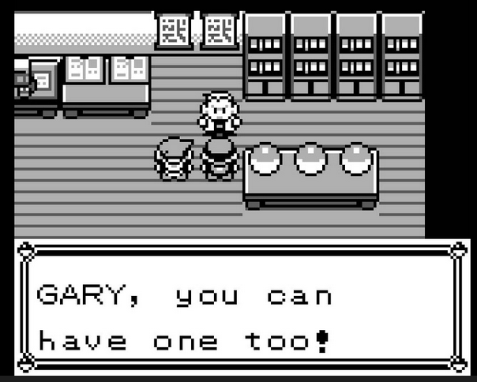
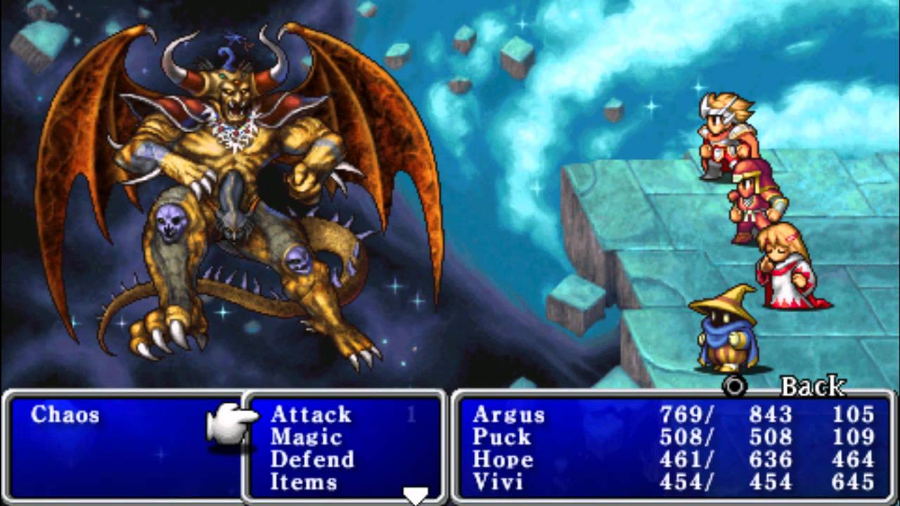
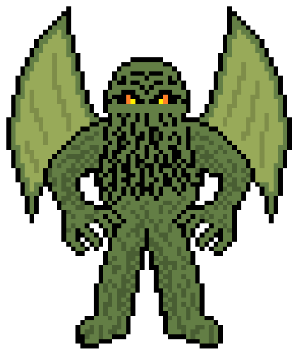

Our Vision
Notes:
What every member of our team has in common, is our love for retro games.
Be it Pokemon on the Gameboy or the Final Fantasy series on the SNES.
We wanted to capture the essence of the games we love and create something
new in the process.
The result is a non-isomorphic 2d-view, like in old school Gameboy games.
With a tile base map and low resolution character models.
As in Pokemon you can catch and collect monsters,
but our monsters are inspired by the world of H.P. Lovecraft.
With this in mind we created our world.

Slide 5
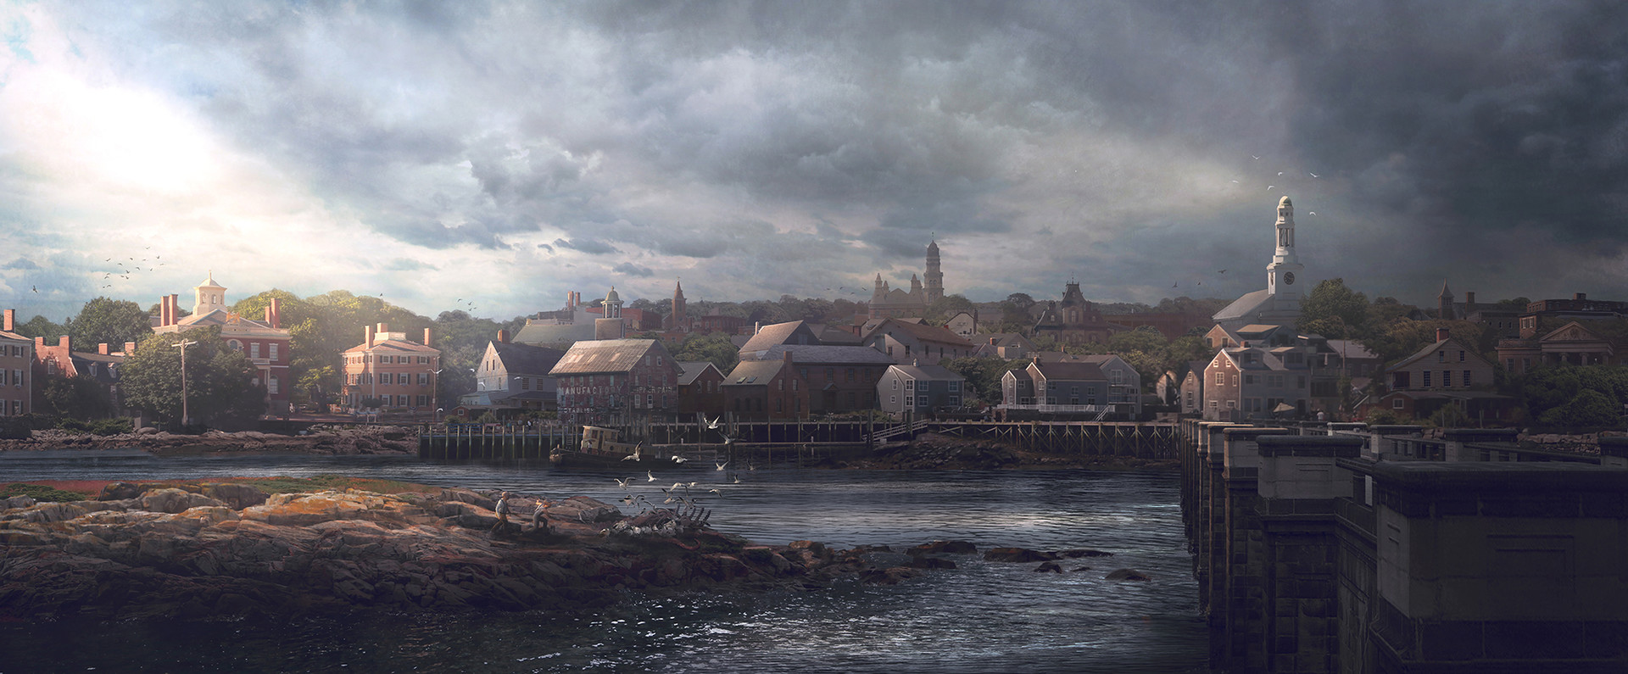
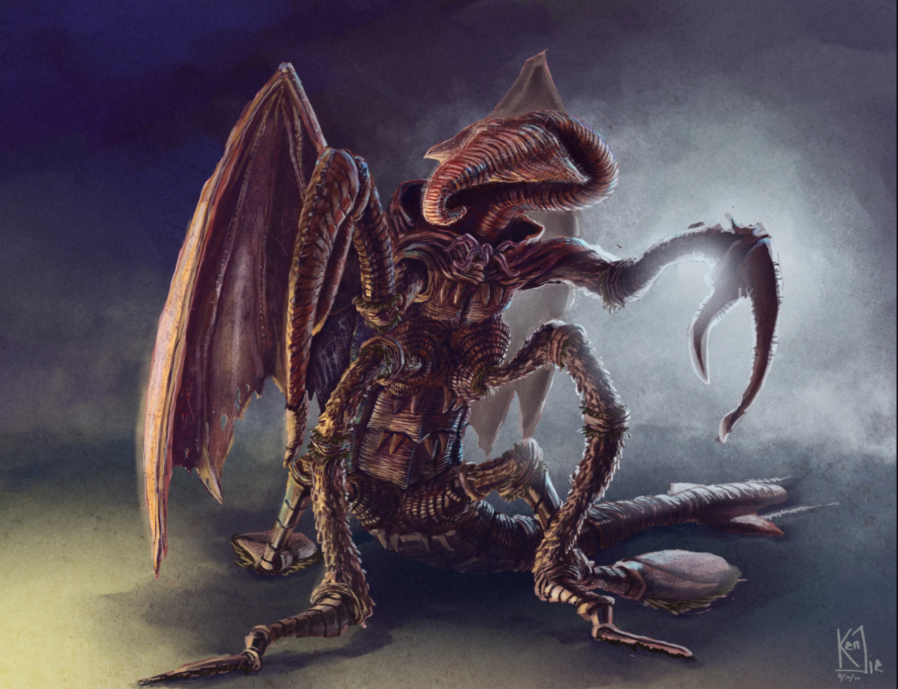
The World
Notes:
So we will start in Arkham City - like every good Story out of Lovecrafts repertoire.
A meteor fell to the ground, leveling the complete campus of the Miskatonic University.
With the meteor strike all animals on the Planet vanished and monsters took their place
little Beasts.
Our protagonist starts into this scenario with their cat, which is the last animal in existence.
This sparks a mystery around the meteor,
what is the role of the University and the protagonist
and how will the world around the city change.

Slide 6
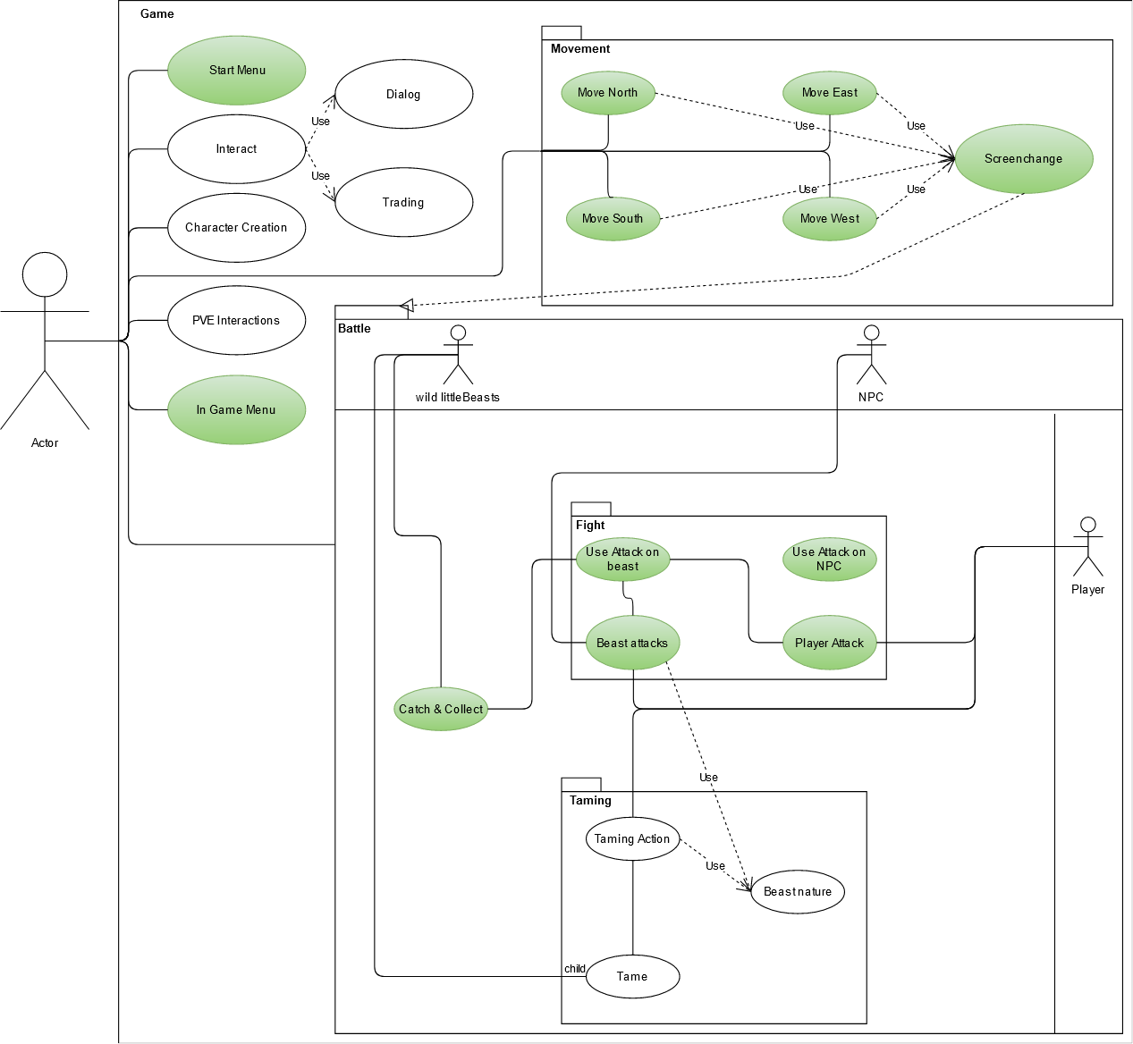
The Scope
Legend:
Green: Current Scope, already implemented
White: tbd.

Slide 7
LIVE DEMO

Slide 8
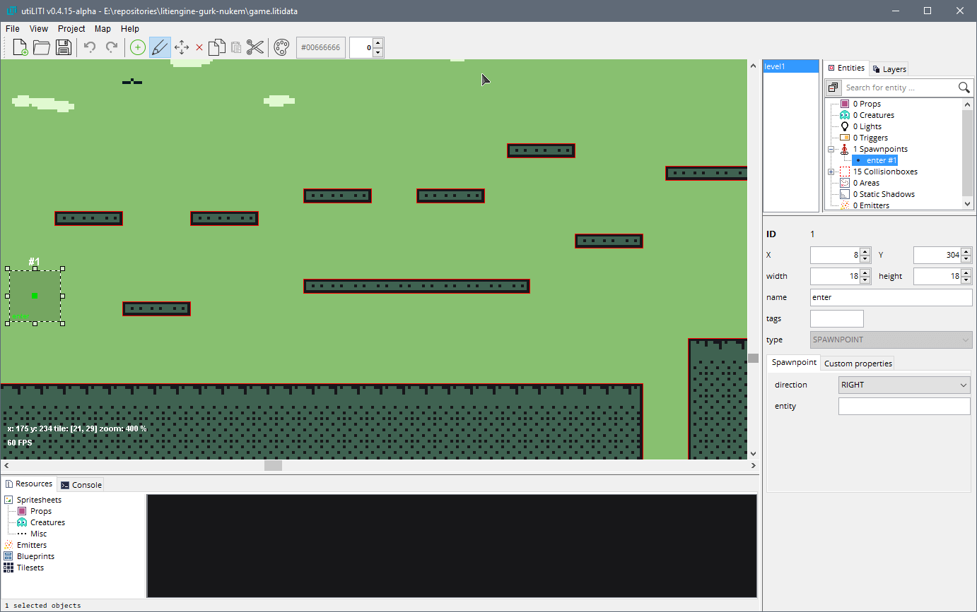



Technologies - LitiEngine
Notes:
Creating a game is an enormous tasks and especially the graphics can be challenging.
So we use LitiEngine in our project. This Engine helps us with recourse management,
For example maps, sprites and sounds.
Also the controller inputs are handled by LitiEngine, this gives us more freedom to
concentrate on the actual game design.
LitiEngine delivers a tool - UtiLiti - to input and manage all resources into a recourse
file which can then be adressed with the Liti Engine in Java.
For the actual map creation we use the "tiled" map editor. This allows us to create
different map layers and works flawlessly in combination with the UtiLiti tool.
As we are no graphic artist we used graphic recourses from the itch.io library.

Slide 9
High-Level Architecture
Com.littleBeasts
Config
CalculationEngine
Screens
Gamelogic
Player Input
Animations
Enum for easy configuration and balancing
Includes data models
Generates entities
Handles Battle
AI for PVE
Future proof -> Multiplayer

Slide 10
Live Test Session

Slide 11
Project management

Slide 12
Roles
Lawand: Implementer, Integrator, Test Manager, Test Designer, Designer
Andreas: Implementer, Integrator, Test Analyst, Designer, Deployment Manager
Daniel: Business Process Analyst, Lead Story Architect, Change Control Manager, Process Engineer
Leon: Project Manager, Change Control Manager, Software Architect

Slide 13



Youtrack / Scrum

Slide 14
Workflow
YouTrack
Research phases
Refactoring
IntelliJ
Code Review
Refactoring
Github
Tests

